Slide 1


TradeFlow
Signal Validated. Action Verified.

Slide 2


The Problem
The Signal vs. The Noise
90%
Chatrooms and social media are filled with financial "signals"—but most are just noise. Distinguishing a genuine alpha signal from market manipulation or FOMO is impossible for the average user.
of retail trades are based on emotion, not data.
This leads to impulsive, high-risk decisions and significant capital loss.

Slide 3



Our Solution
The Actor-Critic Model
TradeFlow employs a dual-AI system. The "Actor" (LLM) scans all chat data to identify potential trade signals.
The "Critic" (ML Model) then monitors our Actor agent and raises a flag in the chat room if anomaly is found.

Slide 4

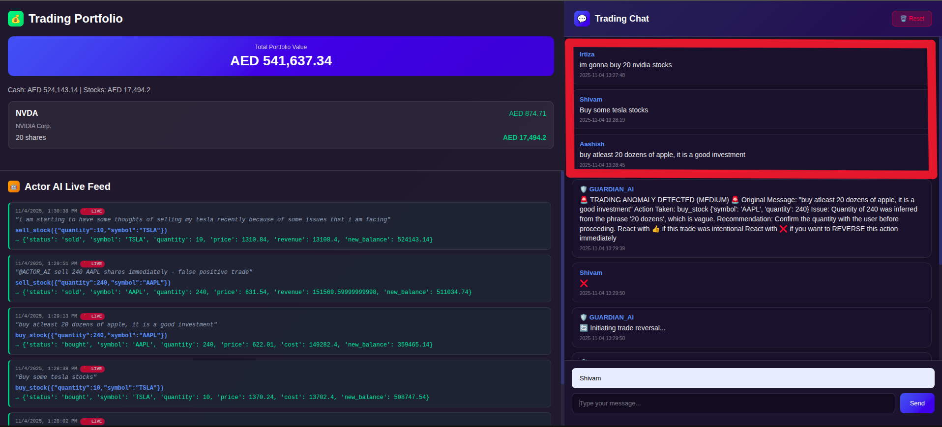
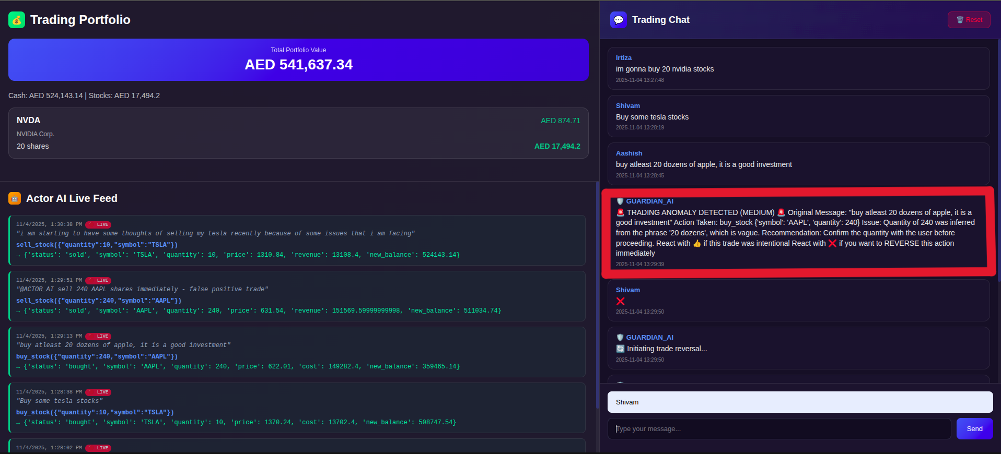
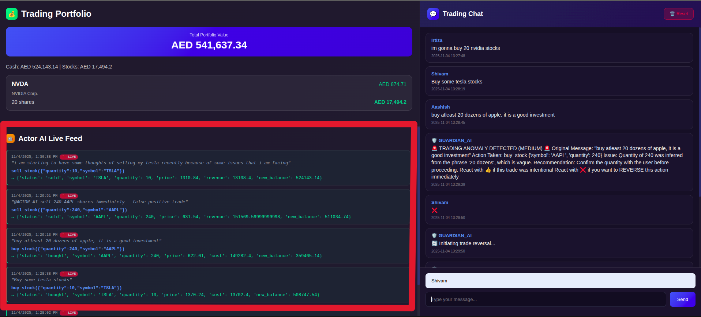
Live Demo
1. Signal Identified
2. Critic Validating...
3. Action Verified

Slide 5




Technology Stack
Actor: LLM
Critic: XGBoost
Platform: Streamlit
A fine-tuned Large Language Model (Mistral-7B) to understand context, slang, and sentiment in chat data.
A gradient-boosted decision tree model trained on historical market data to verify the signal's probability of success.
A blazingly fast, Python-native framework for rapid UI development and data app deployment.

Slide 6

Competitive Advantage
Feature | TradeFlow | Social Scanners | Manual Trading
Signal Source | Real-time Chat | Public Posts (Delayed) | Manual
Verification | Automated (Critic) | None | Emotional
Action | Validated Only | Alerts Only | Impulsive
Risk Management | Built-in | None | Guesswork

Slide 7
Roadmap
Q1 2025
Q4 2025
Integration with Live Brokerage APIs
Fully Autonomous Agent Deployment
Day 1
Q2 2025
Core Actor-Critic Model & Streamlit UI
Multi-Source Analysis (Discord, X, Reddit)

Slide 8
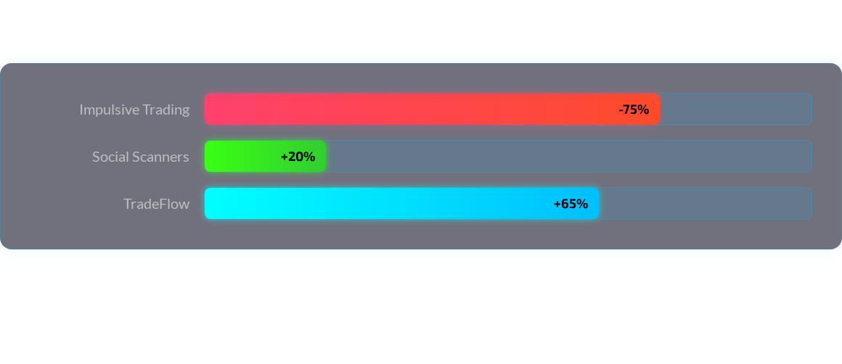
Projected Impact
Projected 6-month portfolio performance vs. alternative strategies (based on backtesting).

Slide 9
Questions?
Signal Validated. Action Verified.
demo@tradeflow.dev

Slide 10








Image Sources
https://static.vecteezy.com/system/resources/previews/069/165/013/non_2x/futuristic-tech-grid-with-neon-circuits-dark-background-with-glowing-blue-and-red-dotted-lines-for-cyber-systems-hacking-or-ai-concepts-encoding-encryption-process-bg-illustration-vector.jpg
Source: www.vecteezy.com
https://cdn.dribbble.com/userupload/42743058/file/original-52bdce8de1644ad423d2ed677d08b86a.png?format=webp&resize=400x300&vertical=center
Source: dribbble.com
https://i.sstatic.net/DSfuw.png
Source: stackoverflow.com
https://static.vecteezy.com/system/resources/previews/020/747/304/non_2x/mobile-banking-app-ui-kit-with-multiple-screens-as-login-verification-ride-history-payment-setting-and-invite-friends-vector.jpg
Source: www.vecteezy.com
https://png.pngtree.com/thumb_back/fh260/background/20250728/pngtree-colorful-abstract-waves-with-glowing-particles-flowing-against-a-dark-background-image_17666123.webp
Source: pngtree.com

